Slide 1
SPP TCR Reference Price Calculation
A review of the SPP TCR Reference Price calculation and a proposal to modify the calculation to reduce over-collateralization
6/15/2017

Slide 2
Motivation
Why over-collateralization is not good:
Illiquid market
Auction values are not reflective of actual market value, but may include the cost of posting such collateral
Inefficiency
Lack of counterflow bids may result in high clearing price on paths that affect binding constraints in the prevailing direction
Auction clearing price becomes less of an efficient forward price.

Slide 3
Principles
Comply with FERC Order 741
Principles:
More credit requirements with Increasing volatility
More credit requirements with Increasing bids
For new nodes that lack historical data, credit calculation should use historical data of the closest nodes

Slide 4
More credit requirements with Increasing volatility
$/MWh Congestion Value
Average
On two paths that have the same Monthly value, when they are bid at the same bid price, the more volatile path on the left will be assessed a higher credit requirement

Slide 5
More credit requirements with Increasing bids
$/MWh Congestion Value
Bid Price 1
Bid Price 2
Average
When comparing two bids on the same path, the more expensive bids on the left will be assessed a higher credit requirement

Slide 6
Current SPP Reference Price Calculation
How is TCR_REFERENCE_PRICE calculated?
Mean
TCR_REFERENCE_PRICE
ETCRE farther away from Mean even though the distribution of value is the same as previous
Stress Test Price based on 90%-tile of the opposite value

Slide 7
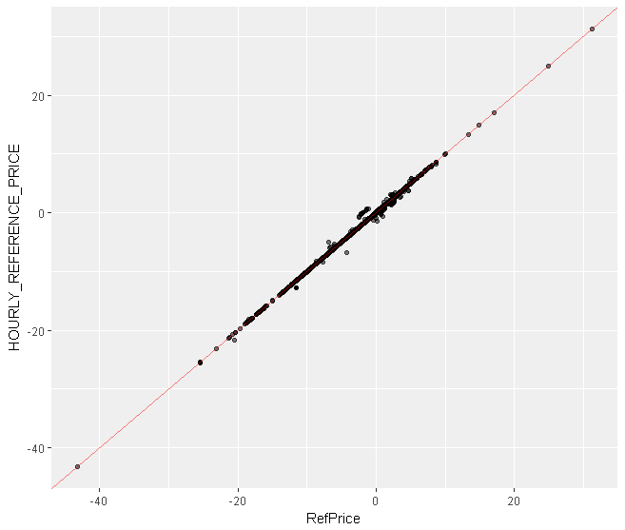
Current SPP Reference Price Calculation Comparing Published v. Calculated Jun_17 OFF
Downloaded Hourly Reference Price $/MWh
Source | Sink | Reference Price in $/MWh
OKGECENTWIND | OKGESNRWIND | 31.28
OKGEKEENANWIND | CSWSLEEPINGBEAR | 24.91
OKGECENTWIND | WR.MW.GMEC.MW | 17.01
Source | Sink | Reference Price in $/MWh
SECI.FPLP.GRAYWIND | WAUE.BEPM.BRADY1 | 0
Source | Sink | Reference Price in $/MWh
OKGESNRWIND | WR.MW.GMEC.MW | -43.24
INDN_MWE_SMKY2 | CSWMAJESTICWIND | -25.47
Calculated Reference Price $/MWh
Calculation matches closely with the SPP published Reference Price

Slide 8
Proposing a Reference Price Calculation
Reflects the “statistical” worst-case congestion value of a particular TCR path for a particular period.
Such that when the product is bid at a particular bid price, the credit requirement corresponds to the spread between the bid price and the “statistical” worst-case congestion value.

Slide 9
Calculating Statistical Worst Case
Given a particular path, we can “simulate” a Monthly value as follows: (suppose there are 400 relevant hours in a given Month)
Step 1: Formulate distribution of the hourly congestion values
Step 2: Draw from the distribution until we collect 400 hourly samples
Step 3: Sum the 400 hourly samples to produce one Monthly sample, repeat Step 2 and 3 to get the next sample until we reach N samples
Given the N Monthly samples, we can say what is the statistical worst-case
5%-tile is generally used when identifying a statistical worst-case

Slide 10
Example of Simulating Monthly Congestion
An example of a TCR Path in Jun_16 OFF OKGESNRWIND to OKGECENTWIND
June 2016 OFF
0% 5% 10% 25% 50% Mean
-127.10960 -72.34076 -60.62520 -45.39283 -31.41060 -32.20895
Frequency
Hourly Congestion $/MWh

Slide 11




Example of Simulating Monthly Congestion
Generating one Monthly sample from sampling the hourly distribution independently
$$Y_{1}$$
$$\sum_{i=1}^{400}{Y_{i} →M_{1}}$$
$$Y_{2}$$
$$Y_{400}$$

Slide 12






Example of Simulating Monthly Congestion
$$Y_{1}$$
Simulated of Monthly Value based on June 2016 OFF Hourly Samples
$$\sum_{i=1}^{400}{Y_{i} →M_{1}}$$
0% 5% 10% 25% 50% Mean
-14396.39 -13564.46 -13411.86 -13129.72 -12844.96 -12828.47
$$Y_{2}$$
$$Y_{400}$$
Frequency
$$Y_{1}$$
$$\sum_{i=1}^{400}{Y_{i} →M_{2}}$$
$$Y_{2}$$
$$Y_{400}$$
$$Y_{1}$$
$$\sum_{i=1}^{400}{Y_{i} →M_{1000}}$$
$$Y_{2}$$
$$Y_{400}$$
Monthly Congestion $/MW

Slide 13
Example of Simulating Monthly Congestion
Hourly Value:
Simulated Monthly Value:
Monthly Average ~= 400 * Hourly Average
June 2016 OFF
0% 5% 10% 25% 50% Mean
-127.10960 -72.34076 -60.62520 -45.39283 -31.41060 -32.20895
Simulated of Monthly Value based on June 2016 OFF Hourly Samples
0% 5% 10% 25% 50% Mean
-14396.39 -13564.46 -13411.86 -13129.72 -12844.96 -12828.47

Slide 14
Example of Simulating Monthly Congestion
Hourly Value:
Simulated Monthly Value:
Monthly Average width = -12828 – (-13564) = 736
Hourly Average width = -32 – (-72) = 40.13181
The ratio is about ~20 = sqrt(400)
June 2016 OFF
0% 5% 10% 25% 50% Mean
-127.10960 -72.34076 -60.62520 -45.39283 -31.41060 -32.20895
Simulated of Monthly Value based on June 2016 OFF Hourly Samples
0% 5% 10% 25% 50% Mean
-14396.39 -13564.46 -13411.86 -13129.72 -12844.96 -12828.47

Slide 15
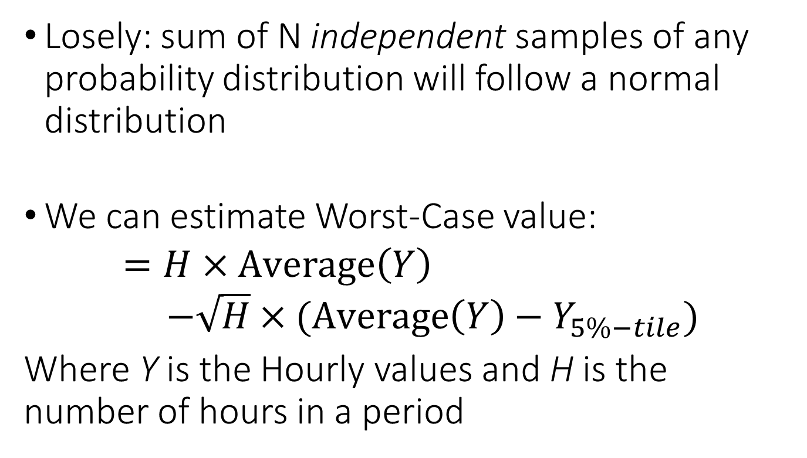
Central Limit Theorem
Losely: sum of N independent samples of any probability distribution will follow a normal distribution
We can estimate Worst-Case value:
$$=H×\text{Average}\left(Y\right) \\ −\sqrt{H}×(\text{Average}\left(Y\right)−Y_{5\%−tile})$$
Where Y is the Hourly values and H is the number of hours in a period

Slide 16

Independence Sampling
Applying Central Limit Theorem underestimates the Monthly variance when the hourly samples are not independent.
May employ a correction factor $α\sqrt{H}$ Instead of $\sqrt{H}$. What is a good $α?$

Slide 17
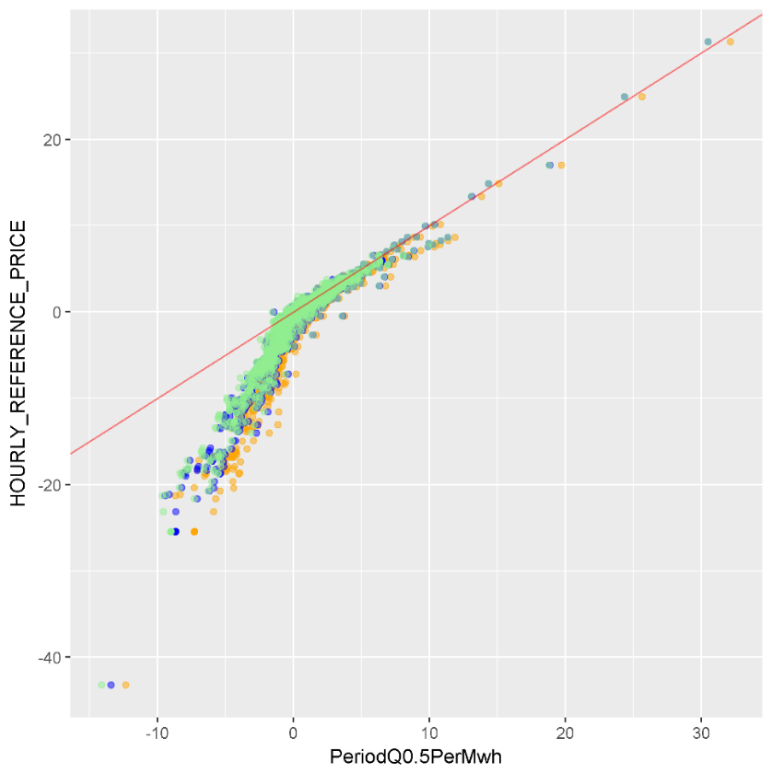
Comparing Reference Price to Statistical Worst-Case Value
Statistical Worst Case
Downloaded Hourly Reference Price $/MWh
Source | Sink | Reference Price in $/MWh | 5%-tile | 2%-tile | 50%-tile
OKGECENTWIND | OKGESNRWIND | 31.28 | 30.53 | 30.53 | 32.17
OKGEKEENANWIND | CSWSLEEPINGBEAR | 24.91 | 24.35 | 24.35 | 25.65
OKGECENTWIND | WR.MW.GMEC.MW | 17.01 | 18.87 | 18.82 | 19.72
Statistical Worst Case
Statistical Worst Case
50%-tile
Source | Sink | Reference Price in $/MWh | 5%-tile | 2%-tile | 50%-tile
OKGESNRWIND | WR.MW.GMEC.MW | -43.24 | -13.40 | -14.10 | -12.34
INDN_MWE_SMKY2 | CSWMAJESTICWIND | -25.47 | -8.67 | -9.00 | -7.27
5%-tile
2%-tile
Calculated Statistical Worst-Case Value $/MWh
Showing Reference Price results in much higher credit requirements on paths that are generally negatively congested

Slide 18
An assessment of how much we are over-collateralizing or under-collateralizing
Backtesting

Slide 19
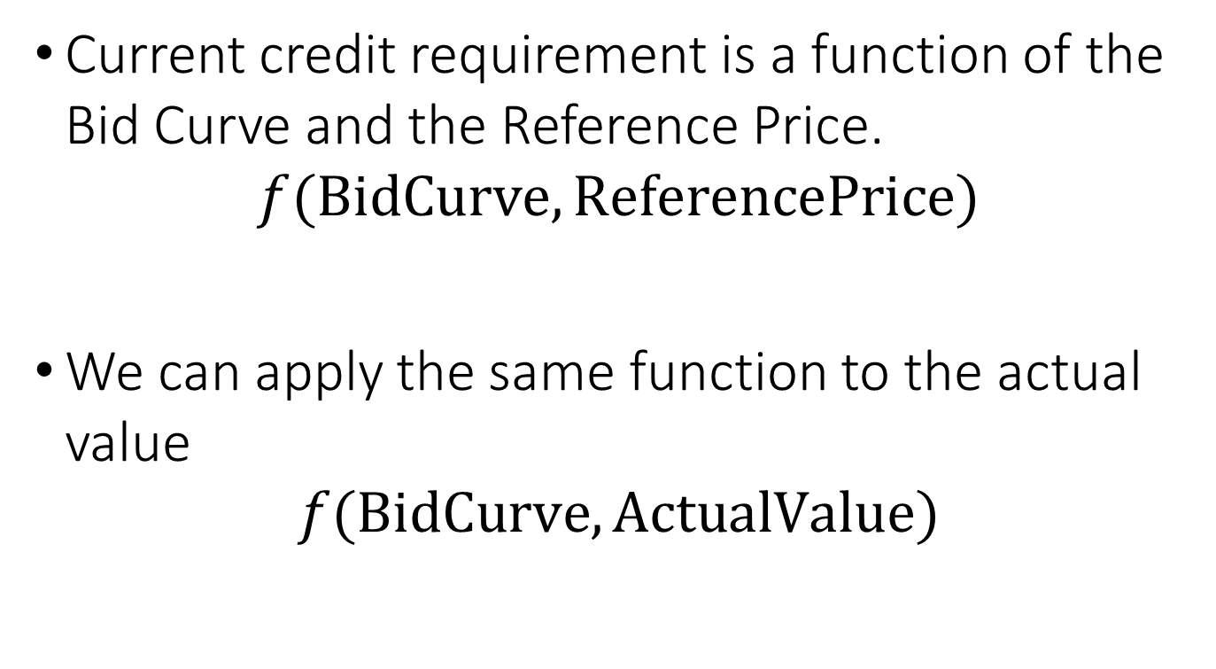
Backtesting Method
Current credit requirement is a function of the Bid Curve and the Reference Price.
$$f(\text{BidCurve}, \text{ReferencePrice})$$
We can apply the same function to the actual value
$$f(\text{BidCurve}, \text{ActualValue})$$

Slide 20
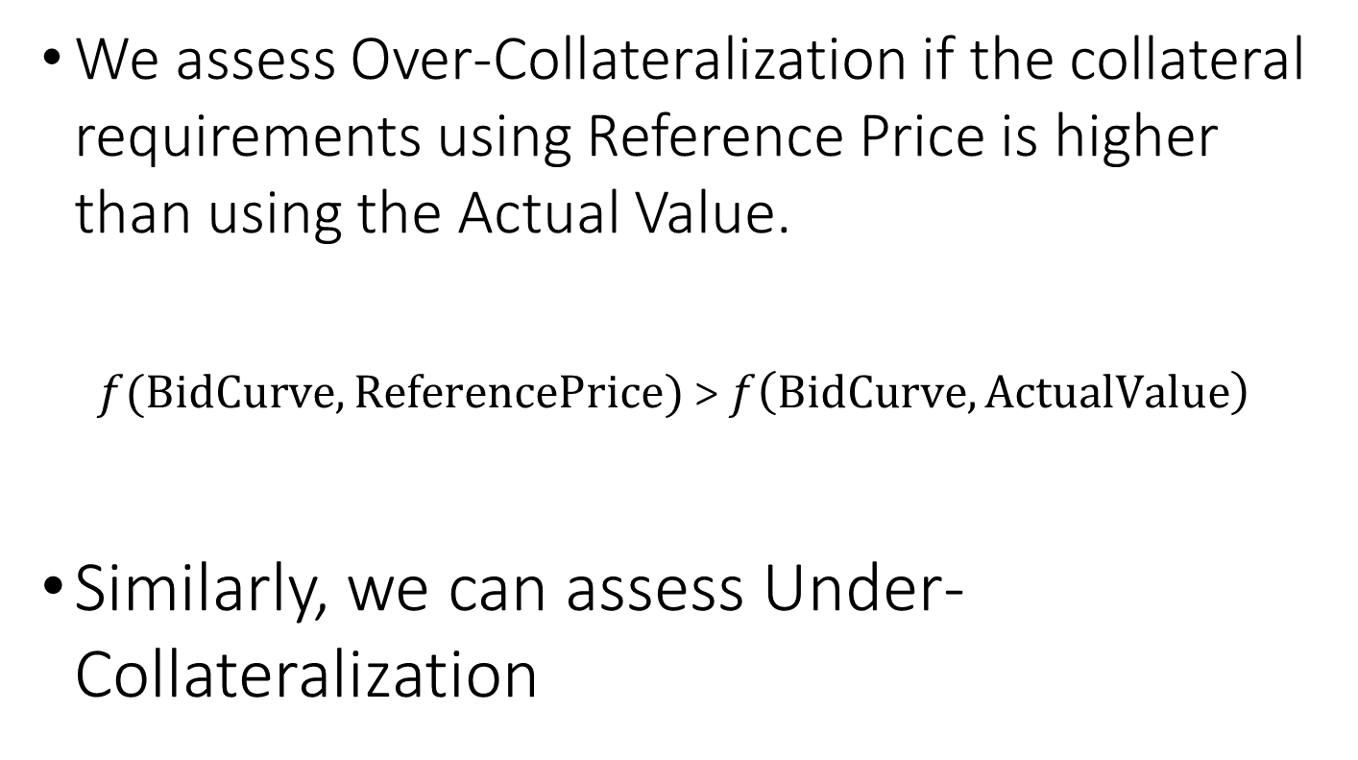
Backtesting Method
We assess Over-Collateralization if the collateral requirements using Reference Price is higher than using the Actual Value.
$f(\text{BidCurve}, \text{ReferencePrice})$ > $f\left(\text{BidCurve}, \text{ActualValue}\right)$
Similarly, we can assess Under-Collateralization

Slide 21
Which bids do we consider?
All Bids
Bids requiring Collateral
Over-Collateralization
Under-Collateralization

Slide 22
Which bids do we consider? (2)
We do not look at the bids that do not require collateral under RefPrice
Specifically, paths that are heavily negatively congested while historically are positively congested are excluded from this analysis
Excluding these bids is appropriate unless we consider Reference Price calculation that understands topological changes on the relevant month

Slide 23
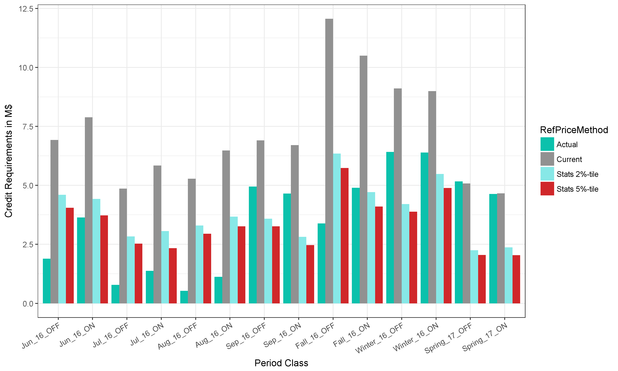
Amount of Collateralization
$12.5M
Amount of Collateralization ($)
$10.0M
$7.5M
$5M
$2.5M
$0

Slide 24
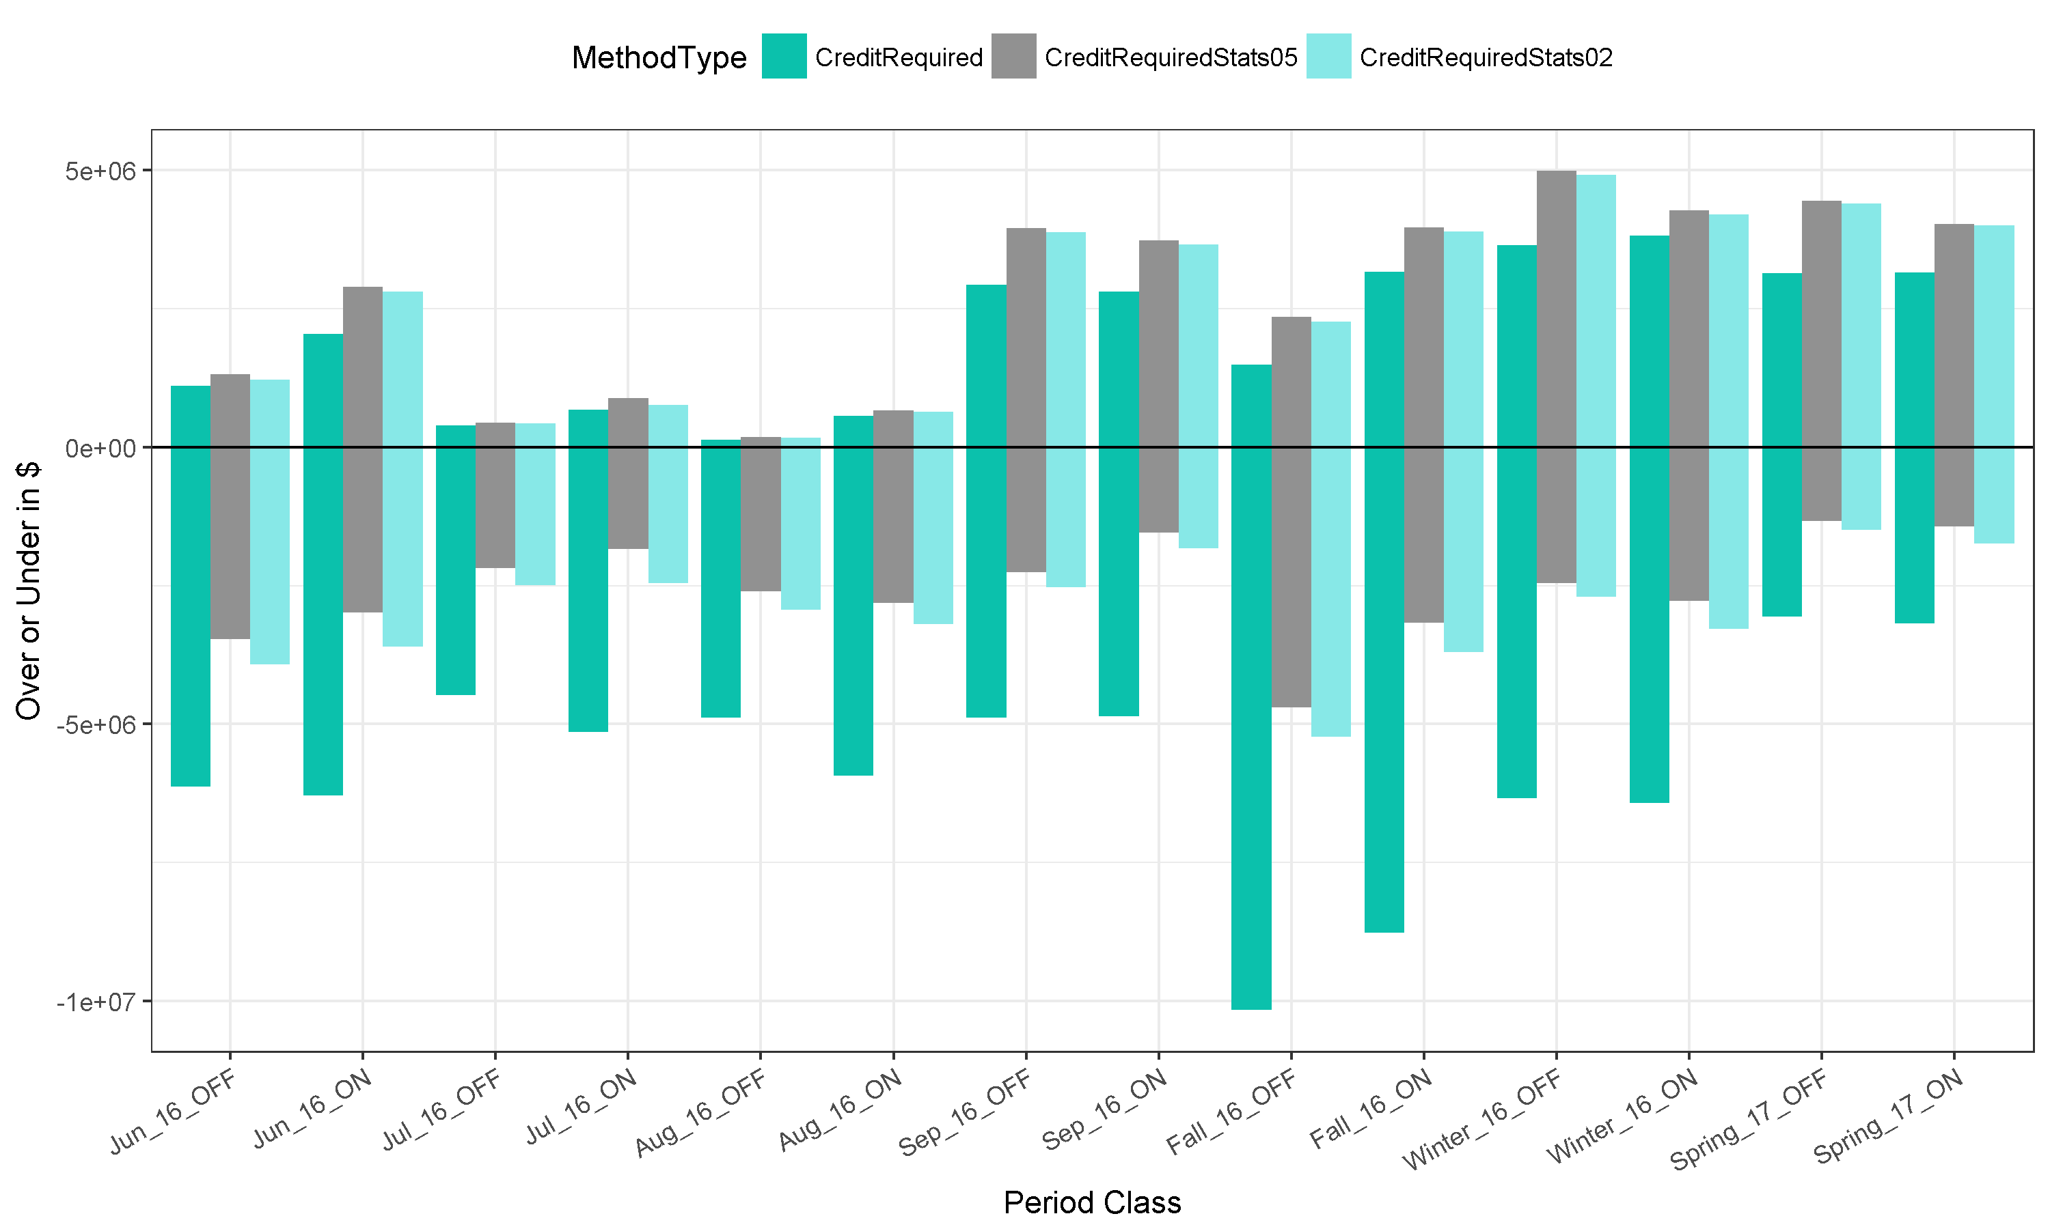
Over / Under Collateralization in $
Under-Collateralized
$5M
5.0M
4.9M
3.6M
$0M
-2.4M
-2.6M
-$5M
-6.3M
-$10M
Over-Collateralized

Slide 25
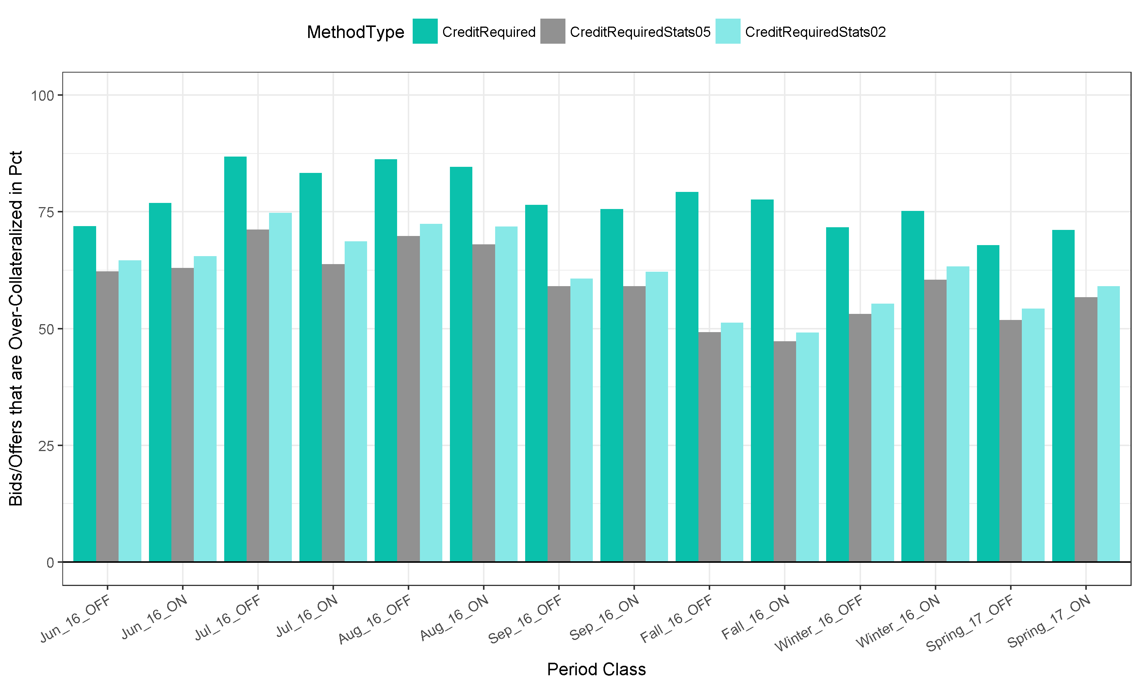
Over-Collateralization in Pct of Bids

Slide 26
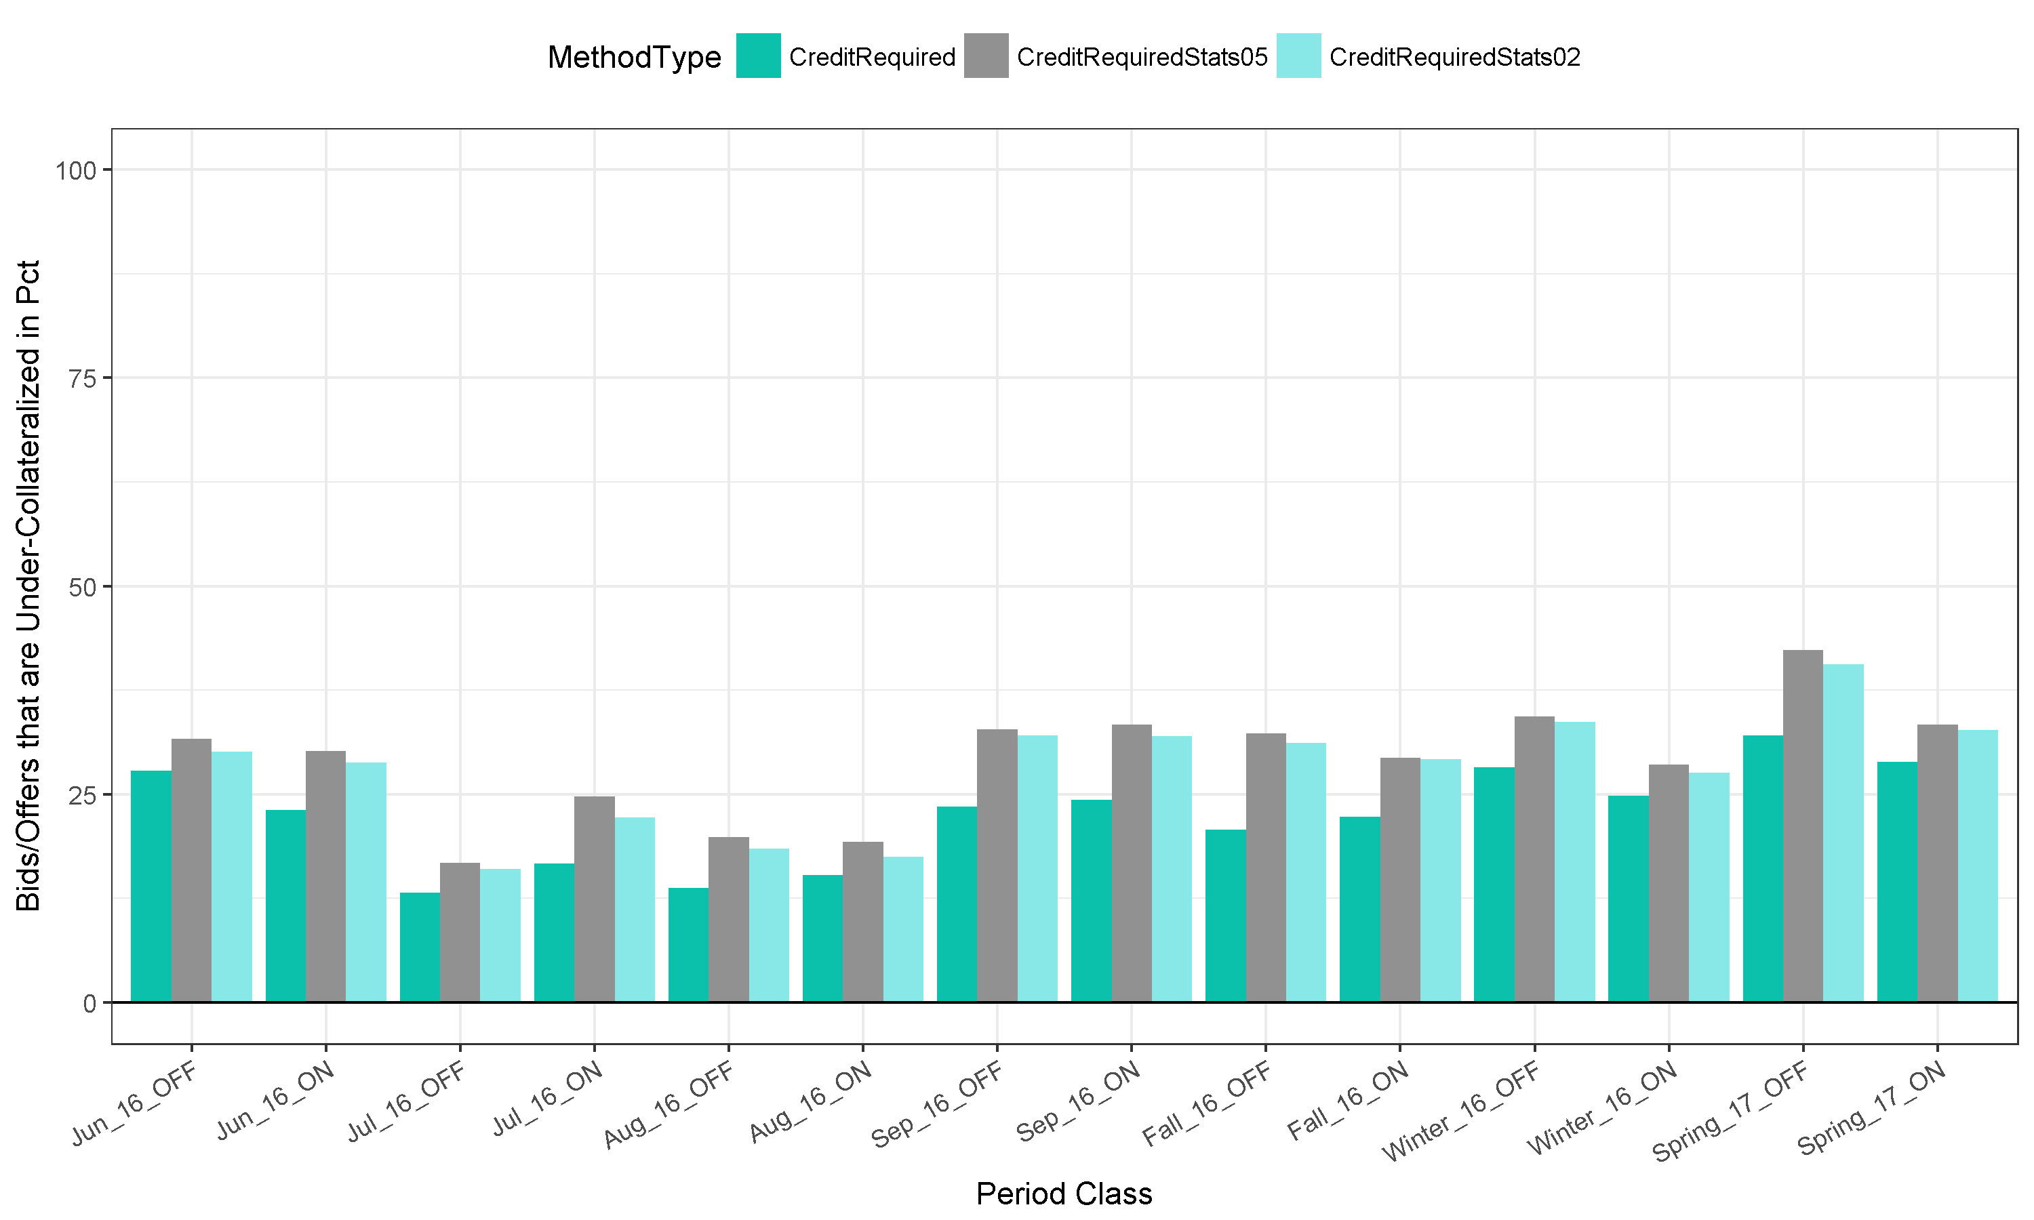
Under-Collateralization in Pct of Bids

Slide 27
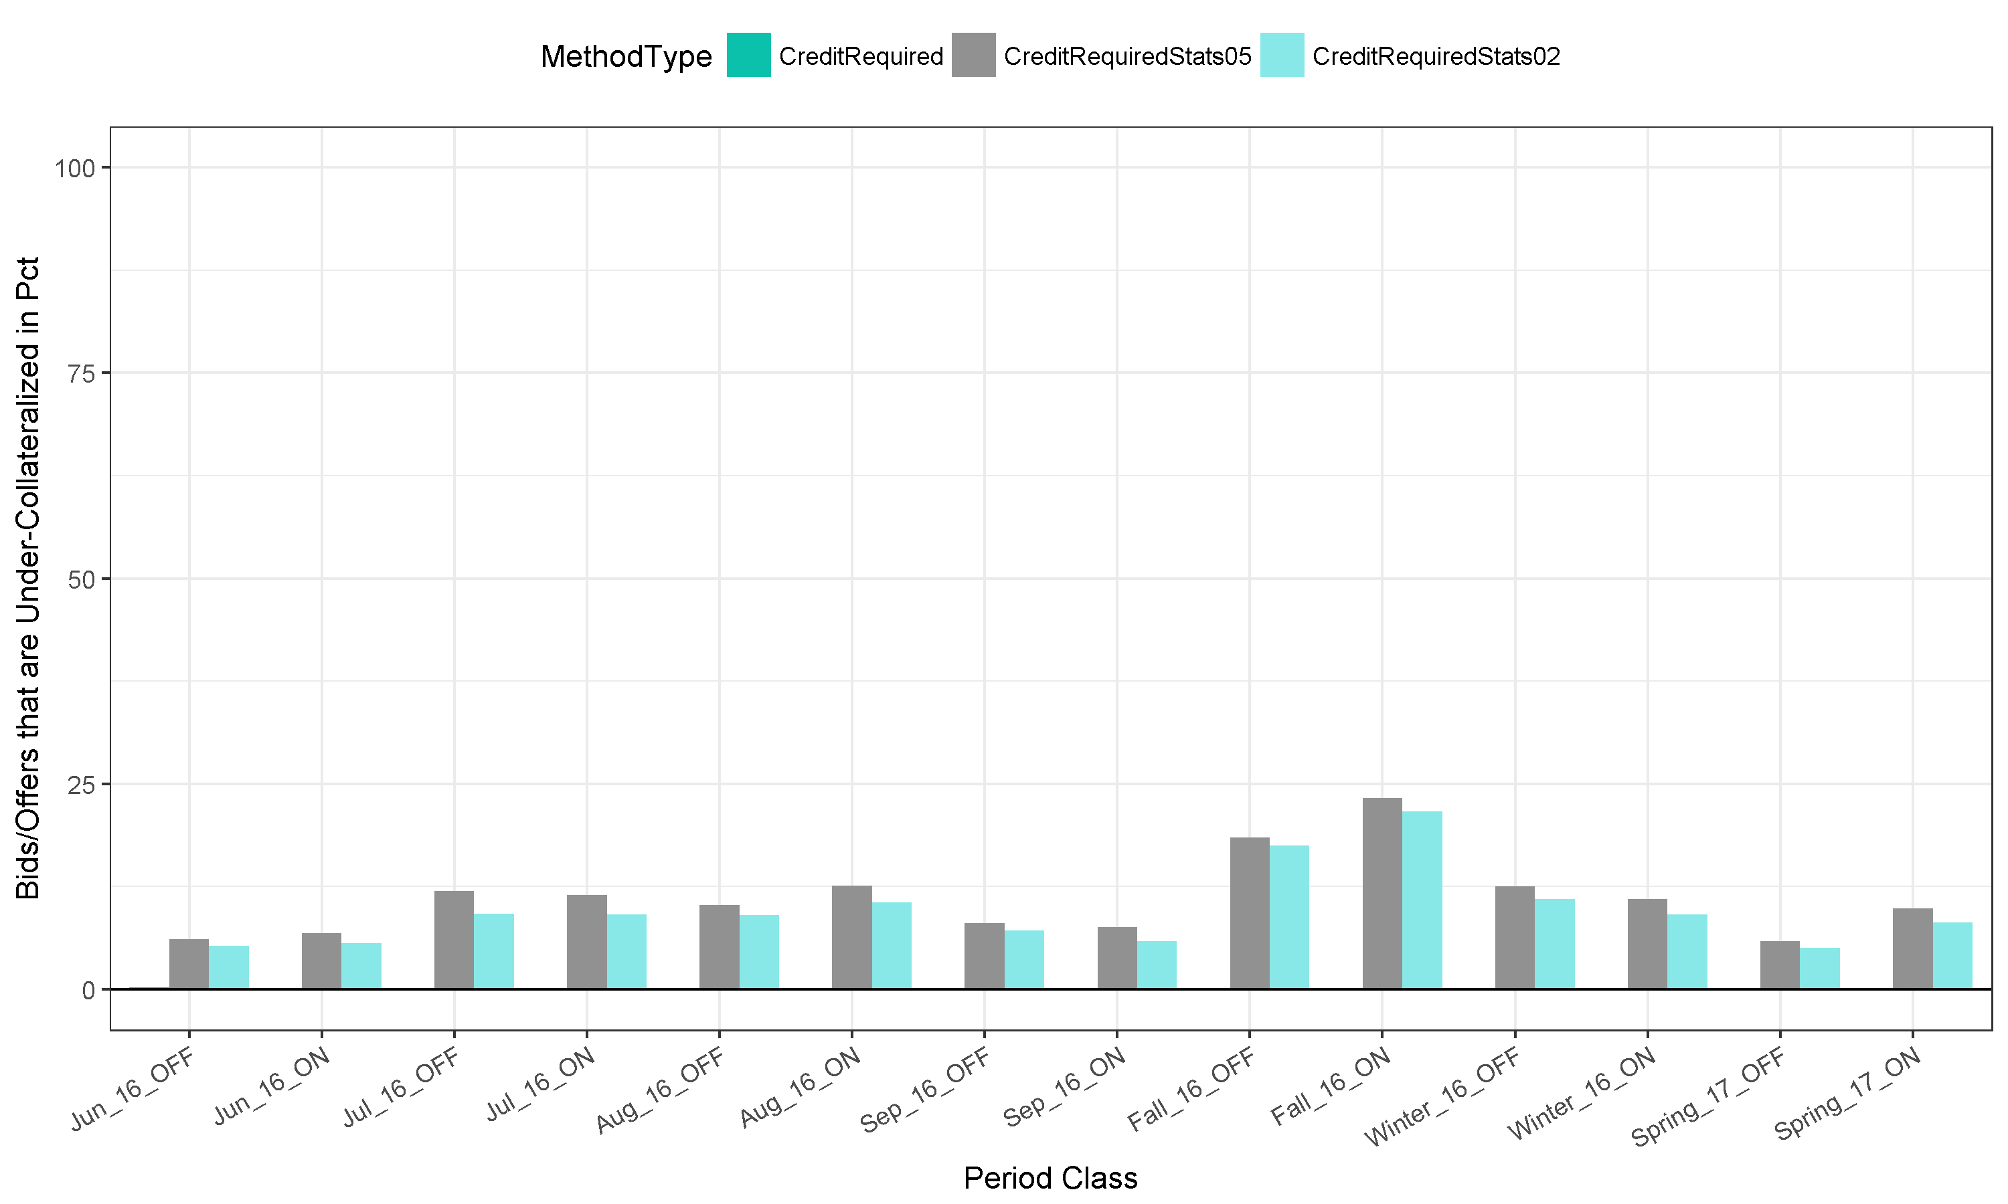
Equal-Collateralization in Pct of Bids
Zero collateral is requested in both Actual and the referred Method

Slide 28
Over-Under by bids
Credit Required
Using Today RefPrice
Over-Collateralized
Under-Collateralized
Under-Collateralized
Over-Collateralized
Under-Collateralized using StatisticalWorst
But Over-Collateralized using today RefPrice
Credit Required using Statistical Worst Case

Slide 29
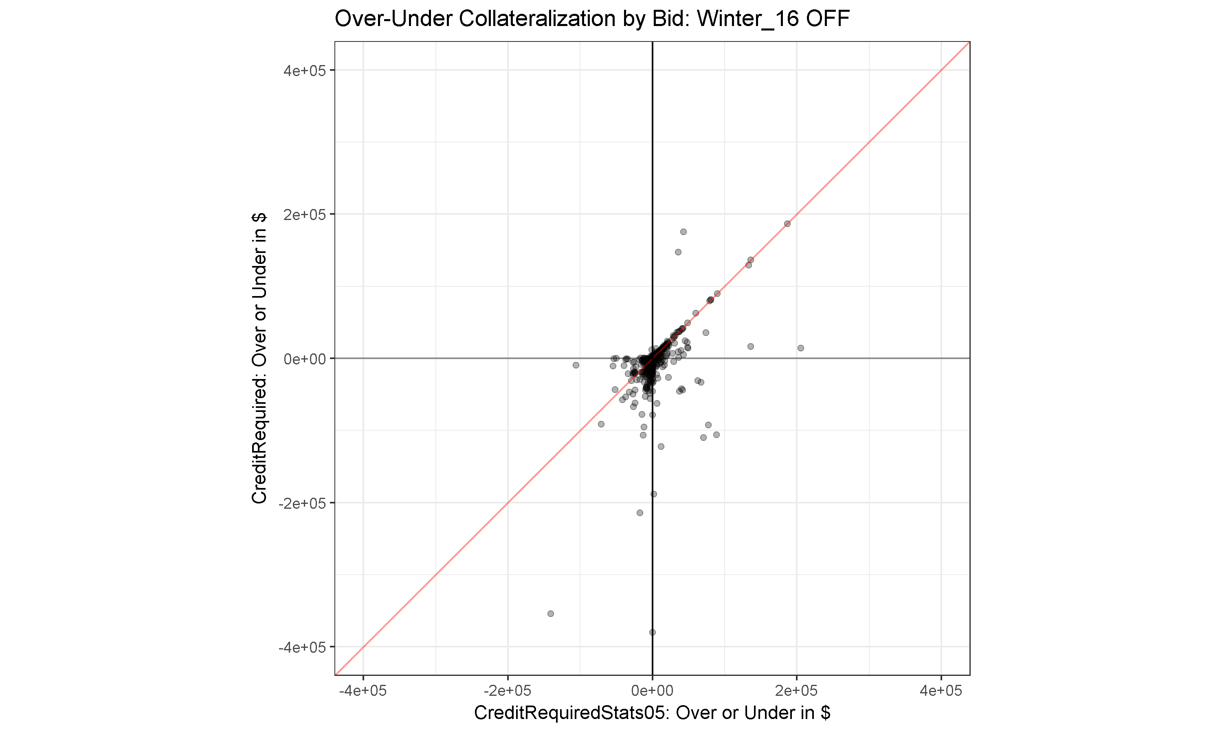
Over-Under in more details for Winter_16 OFF (1104 bids)
SPS.PANTEXWND to CSWMAJESTICWIND
RefPrice: $-31.61 $/MWh
Statistical Worst: $-4.45 $/MWh
Actual: -0.64 $/MWh
Bid:
0 MW at -5 $/MWh
10 MW at -7 $/MWh
Reference Price is skewed due to high negative congestion in January – March 2016
$400K
$200K
NPPD_COOPR to NPPD_NPPD:
RefPrice: $-0.85 $/MWh
Statistical Worst: $-0.05 $/MWh
Actual: -0.91 $/MWh
Statistical worst-case is skewed due to positive congestion in March 2015.
The size of $ is also influenced by the number of hours in a given period. For Winter_16 OFF it is 1543 hours. The size of $ is also influenced by the amount of MW requested. Cooper is a big nuclear unit.
$0
MPSSIBLEYUN3 to MPS_MPS:
RefPrice: $-0.76 $/MWh
Statistical Worst: $-0.35 $/MWh
Actual: -0.07 $/MWh
The size of $ is also influenced by the number of hours in a given period. For Winter_16 OFF it is 1543 hours. The size of $ is also influenced by the amount of MW requested: 335 MW.
-$200K
-$400K
-$400K
-$200K
$0
$200K
$400K

Slide 30
Over / Under Collateralization Ratio
Using Statistical Worst Case of 5%-tile:
Savings Market Participants over-collateralization: $44,967,333
For the risk of under-collateralizing: 9,046,537
Or a ratio of 5.0
Using Statistical Worst Case of 2%-tile:
A ratio of 4.8
MethodType | Over-Collateralized ($) | Under-Collateralized ($) | Over-Collateralized #Bids | Under-Collateralized #Bids
CreditRequired | $ (80,512,746) | $ 29,065,516 | 16,366 | 4,545
CreditRequiredStats05 | $ (35,545,413) | $ 38,112,053 | 12,684 | 5,918
CreditRequiredStats02 | $ (41,092,204) | $ 37,258,709 | 13,279 | 5,655

Slide 31
Observations
Comparing to today Reference Price in Annual Auction of PY2016-2017
While Statistical Worst results in more under-collateralization by $9M, it provides a savings of over-collateralization by $45M
The Under-Over Collateralization Charts show that for most bids the credit requirements using Statistical Worst and Today Reference Price are comparable (following the diagonal lines).
The savings on the over-collateralization and under-collateralization are on Winter periods with many hours (OFF/ON: 1543/1361 hours) and high MW bids.
More savings on the over-collateralization is due to zero collateral bids using Statistical Worst method but significant amount of collateral is required using today reference price.
Namely, bid price is lower than Statistical Worst and Actual congestion but higher than Today Reference Price.
Over-Under Collateralization Charts for all periods are included in the Appendix section.

Slide 32
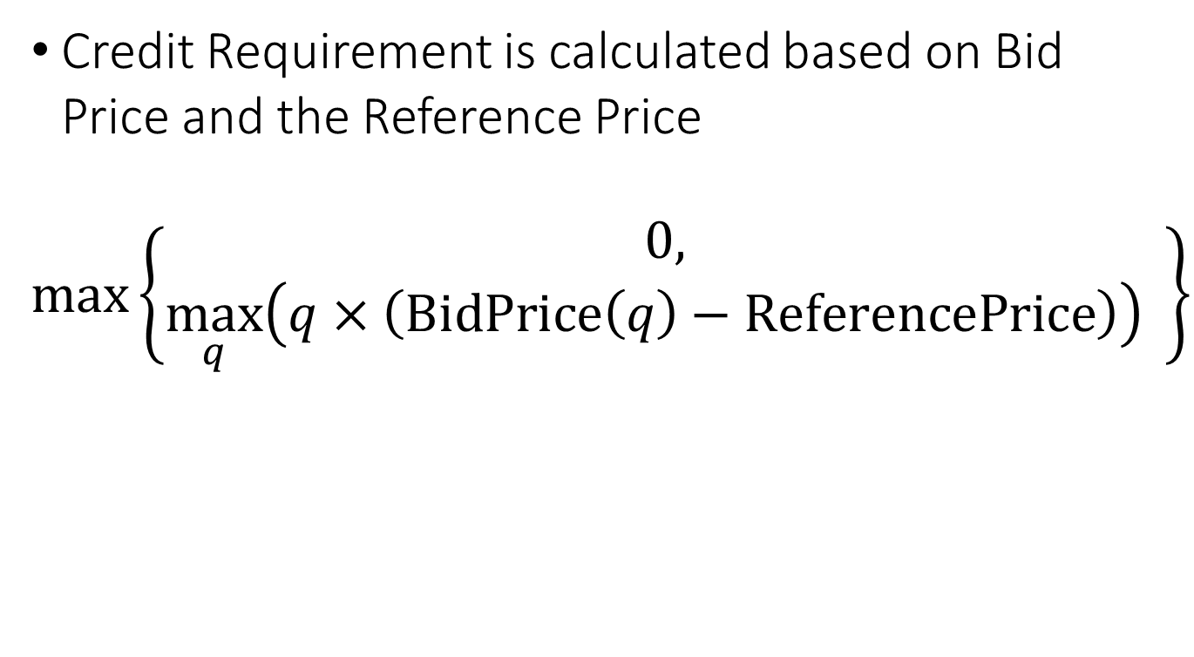
Credit Requirements
Credit Requirement is calculated based on Bid Price and the Reference Price
$$\max\left\{\begin{aligned}0, \\ \max_{q}\left(q×\left(\text{BidPrice}\left(q\right)−\text{ReferencePrice}\right)\right) \end{aligned}\right\}$$

Slide 33
Proposal #1
Replace current calculation of Reference Price with Statistical Worst-Case Value

Slide 34
Credit calculation involving new nodes

Slide 35
New Nodes
Currently Reference Price calculation for paths involving new nodes will use the MCC average across all SPP points
But by definition, the MCC congestion pricing if weighted by load power withdrawal is equal to zero.
If sink points in general have negative MCC (like in Sunflower, Nebraska, or Westar), then most likely any paths sourcing at new nodes will require credits
If sink points in general have positive MCC (like in OKGE, EDE, or WFEC), then most likely any paths sourcing at new nodes will require credits
And what about when both Source and Sink are new nodes. For example the path SECI.FPLP.GRAYWIND to WAUE.BEPM.BRADY1?
Currently Reference Price for such path is zero.

Slide 36
If we look at the new paths
Over / Under collateralization on paths that are flagged with YEAR_1_PROXY_PRICE_IND
Method | Over-Collateralization ($) | Under-Collateralization ($) | Over-Collateralization #Bids | Under-Collateralization #Bids
CreditRequired | $ (14,433,413) | $ 3,699,350 | 2,995 | 680
CreditRequiredStats05 | $ (7,200,098) | $ 4,071,253 | 2,476 | 813
CreditRequiredStats02 | $ (7,545,183) | $ 4,040,428 | 2,490 | 808

Slide 37
Proposal #2
On calculating the reference price for paths involving New Nodes, SPP will use historical data of the node that is physically closest to the new node.

Slide 38
Contact
Justin Riddell
jriddell@teainc.org
Yohan Sutjandra
ysutjandra@teainc.org

Slide 39
Appendix

Slide 40
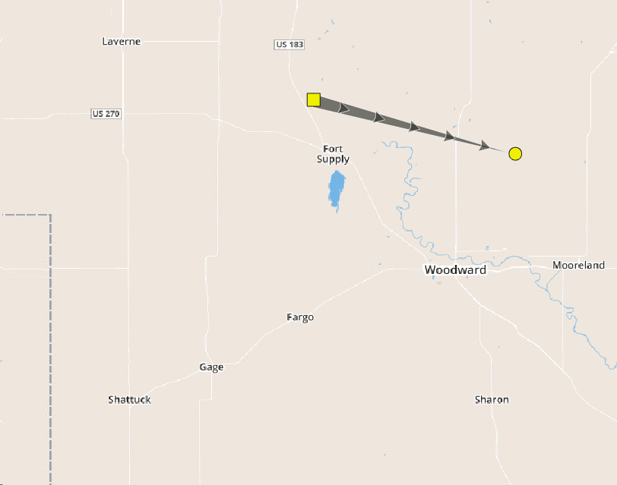
OKGECENTWIND to OKGESNRWIND
June 2016 OFF
Reference Price is exactly at Mean Price of 31.28 $/MWh
5% 10% 25% 50%
0.00030 3.18864 13.48485 31.41060
Texas
Oklahoma
Map Source: YesEnergy

Slide 41
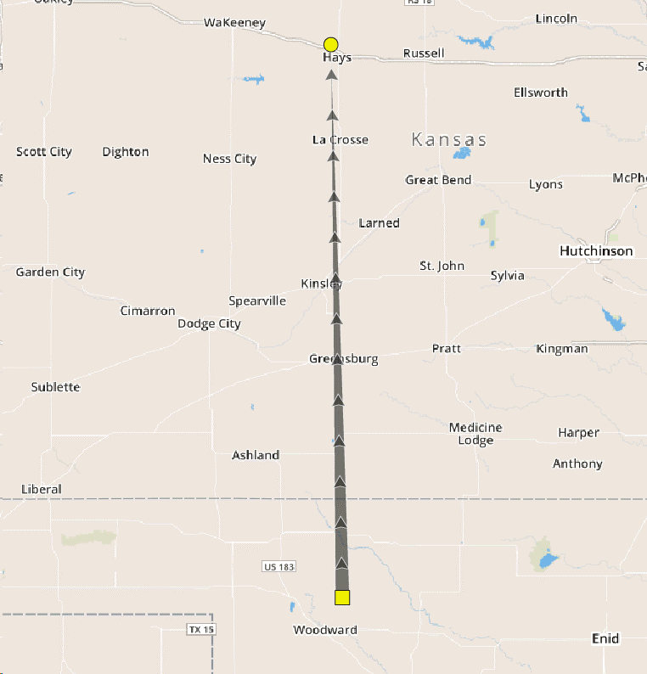
OKGESNRWIND to WR.MW.GMEC.MW
June 2016 OFF
Reference Price is -43.24 $/MWh is further out compared to the 5% tile.
5% 10% 25% 50%
-32.28321 -24.57508 -19.17780 -11.91885
Kansas
Oklahoma
Texas
Map Source: YesEnergy

Slide 42
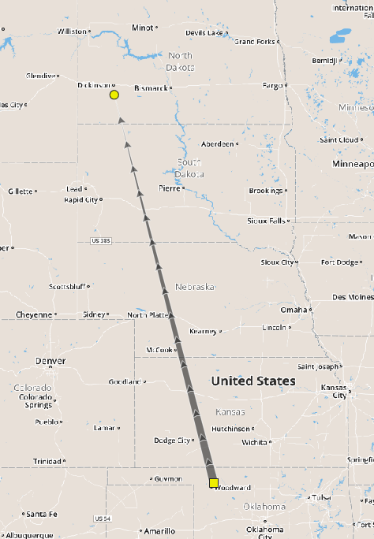
SECI.FPLP.GRAYWIND to WAUE.BEPM.BRADY1
January 2017 – April 2017 OFF
Both nodes are new nodes, current SPP Reference Price calculation results in 0 $/MW, for both directions
5% 10% 25% 50% Mean
-3.518920 -0.422220 0.820550 4.720600 6.193856
Map Source: YesEnergy

Slide 43
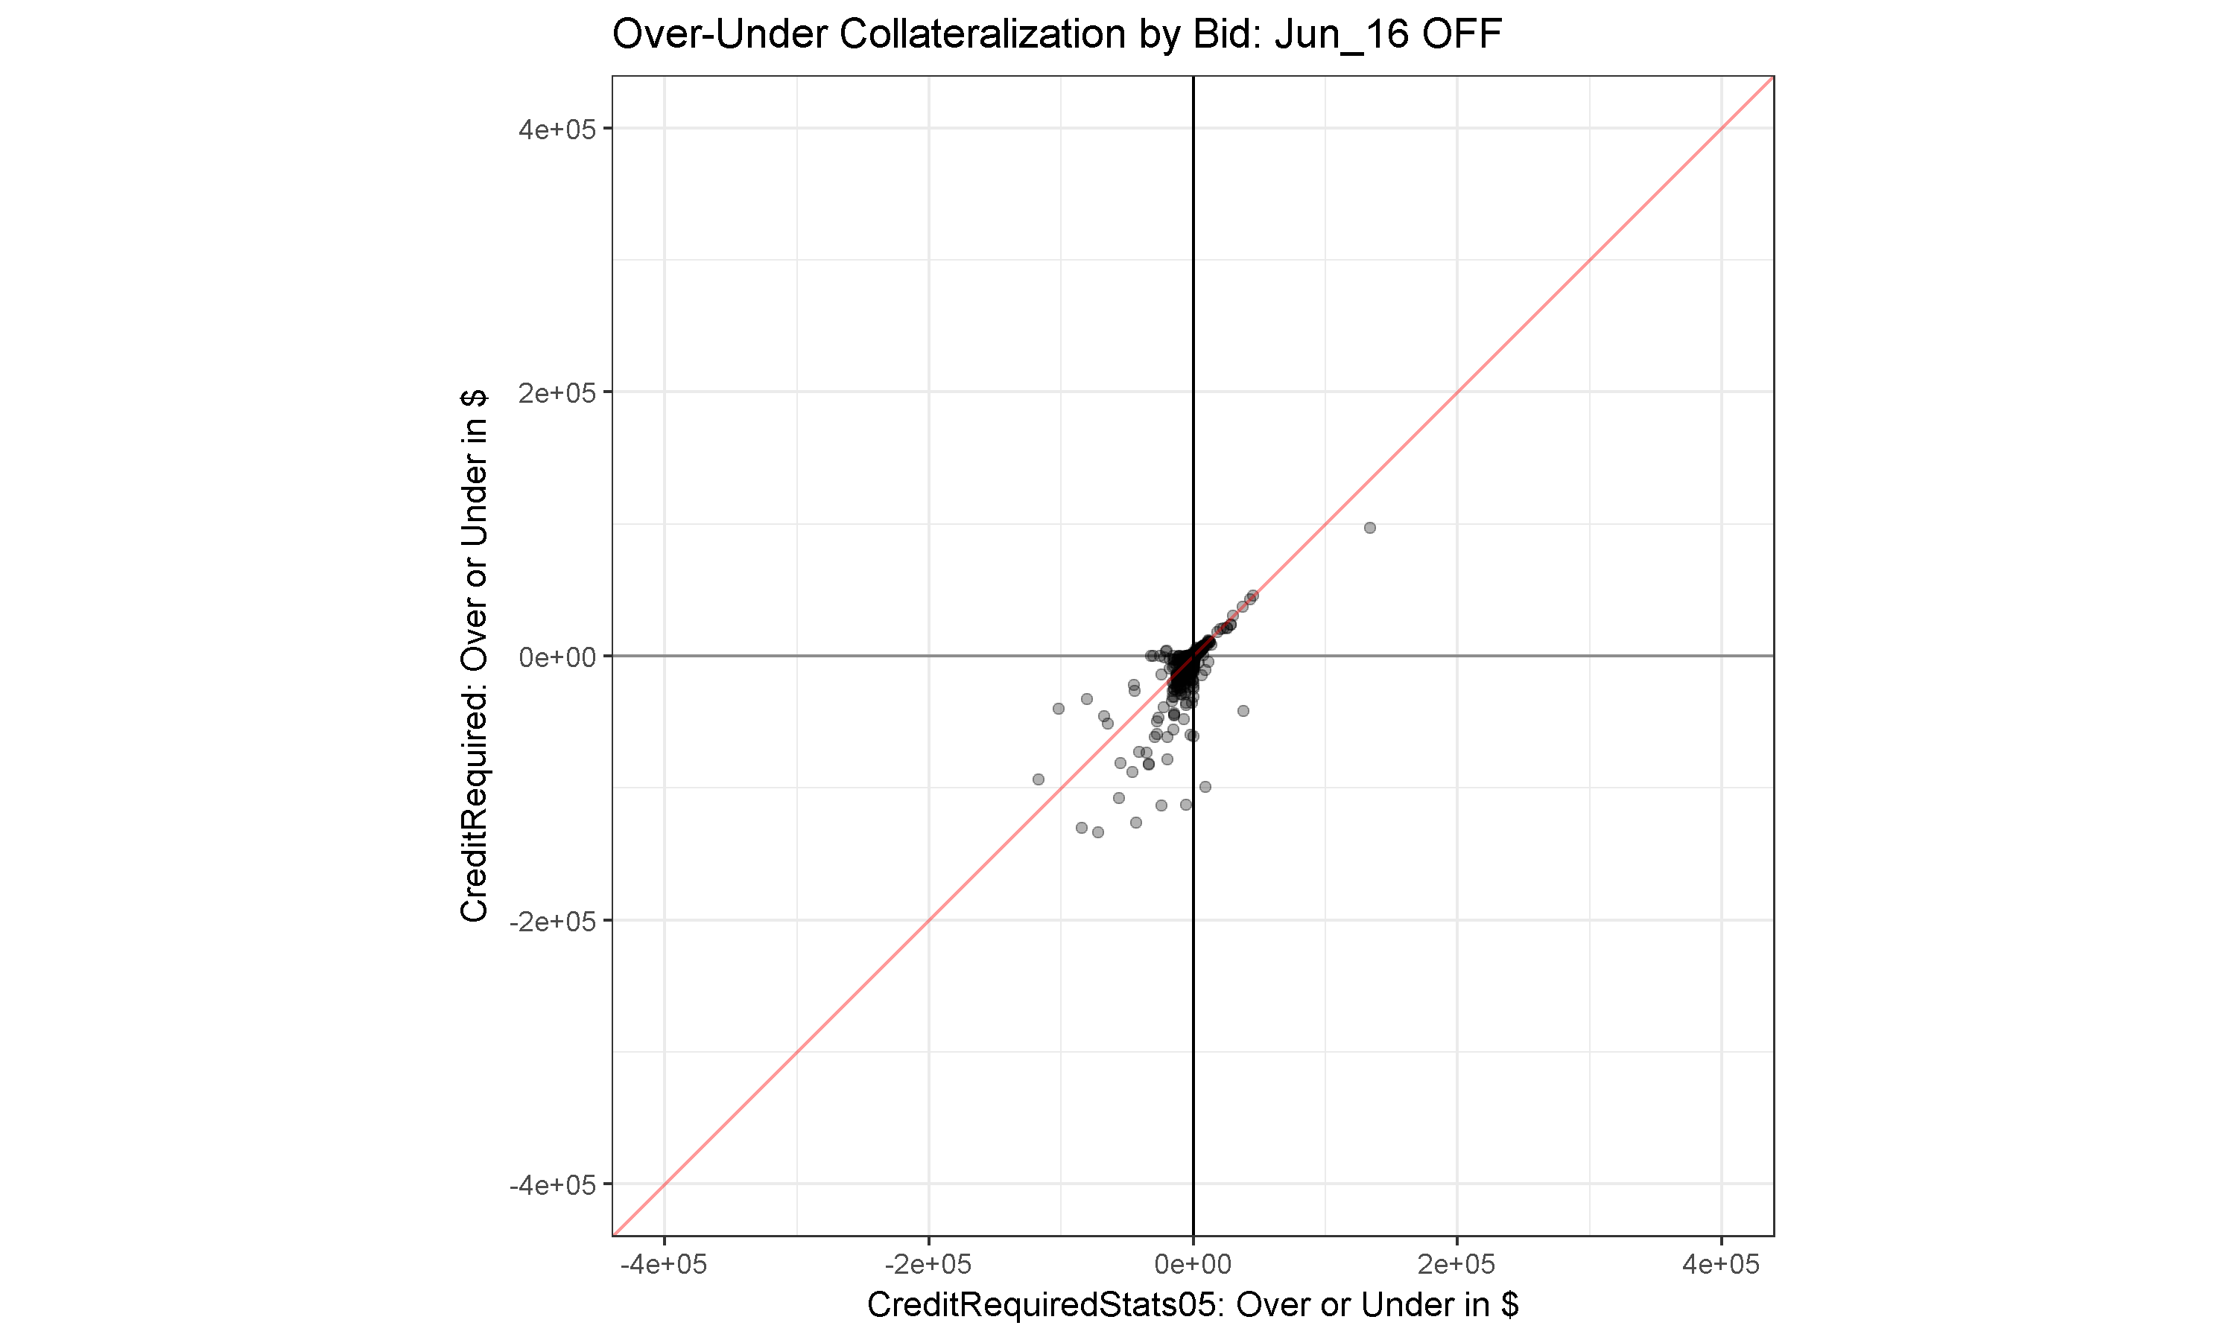
$400K
$200K
$0
-$200K
-$400K
-$400K
-$200K
$0
$200K
$400K

Slide 44

$400K
$200K
$0
-$200K
-$400K
-$400K
-$200K
$0
$200K
$400K

Slide 45
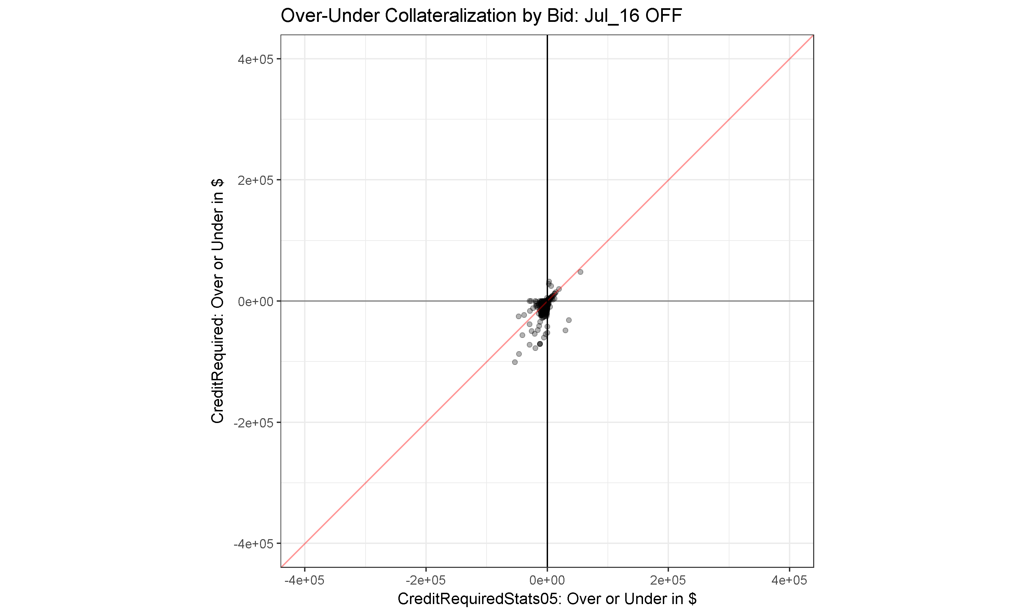
$400K
$200K
$0
-$200K
-$400K
-$400K
-$200K
$0
$200K
$400K

Slide 46
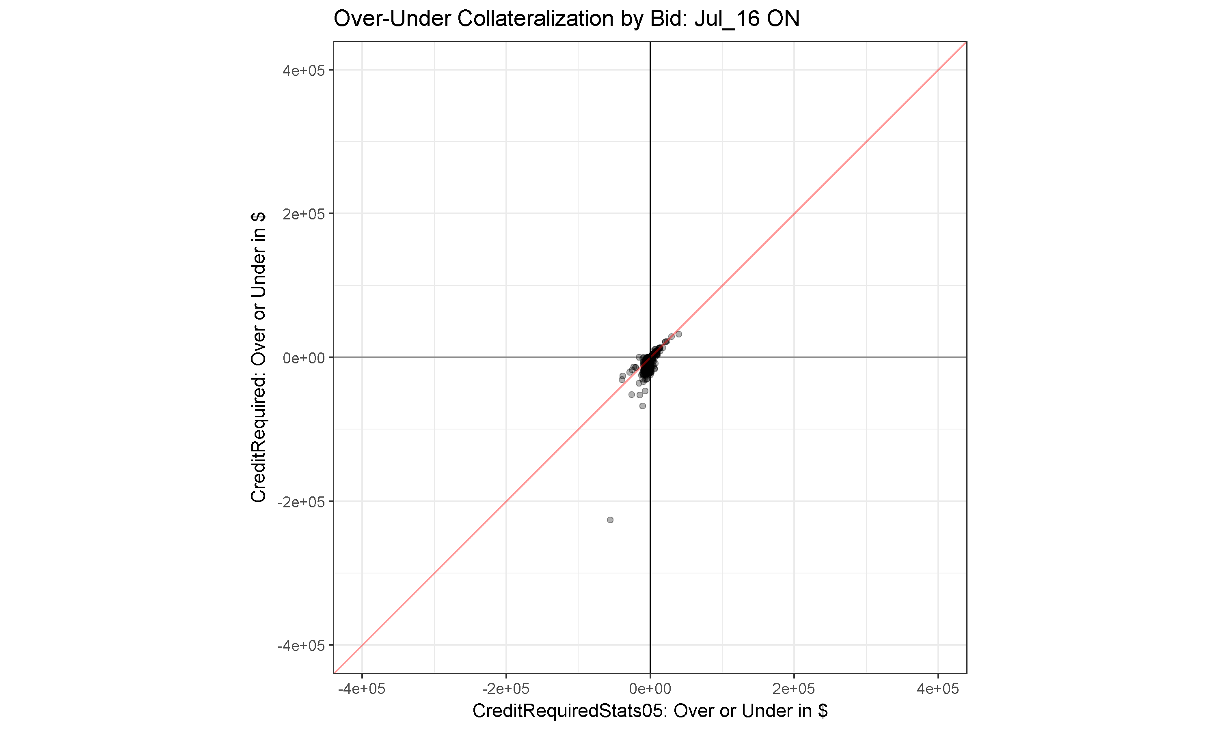
$400K
$200K
$0
-$200K
-$400K
-$400K
-$200K
$0
$200K
$400K

Slide 47
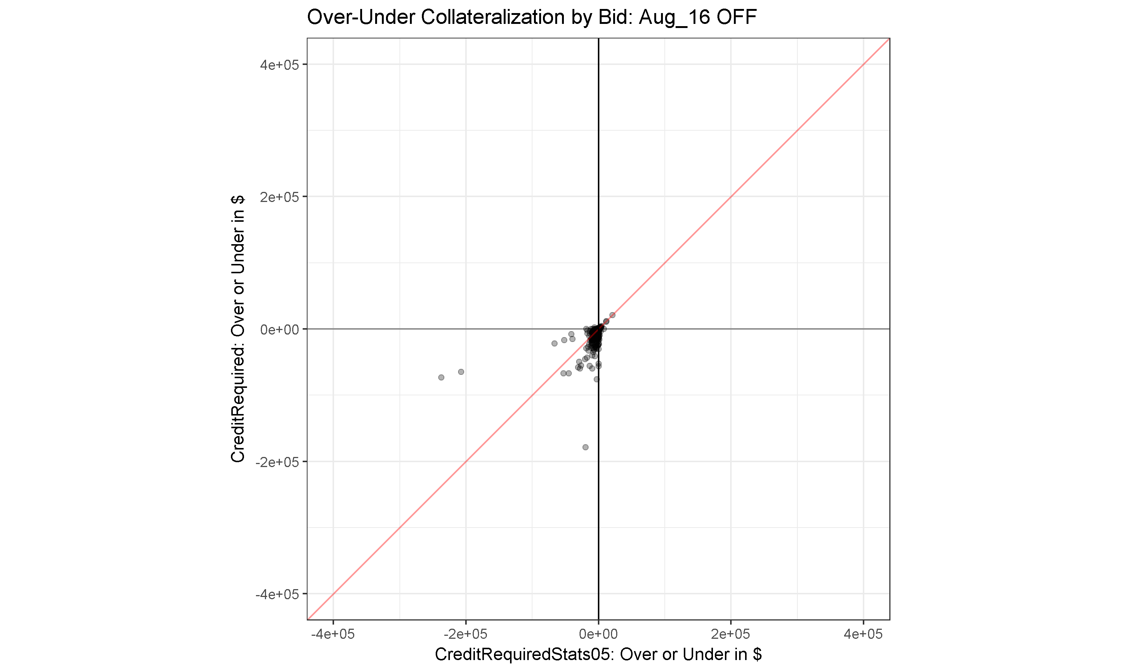
$400K
$200K
$0
-$200K
-$400K
-$400K
-$200K
$0
$200K
$400K

Slide 48

$400K
$200K
$0
-$200K
-$400K
-$400K
-$200K
$0
$200K
$400K

Slide 49
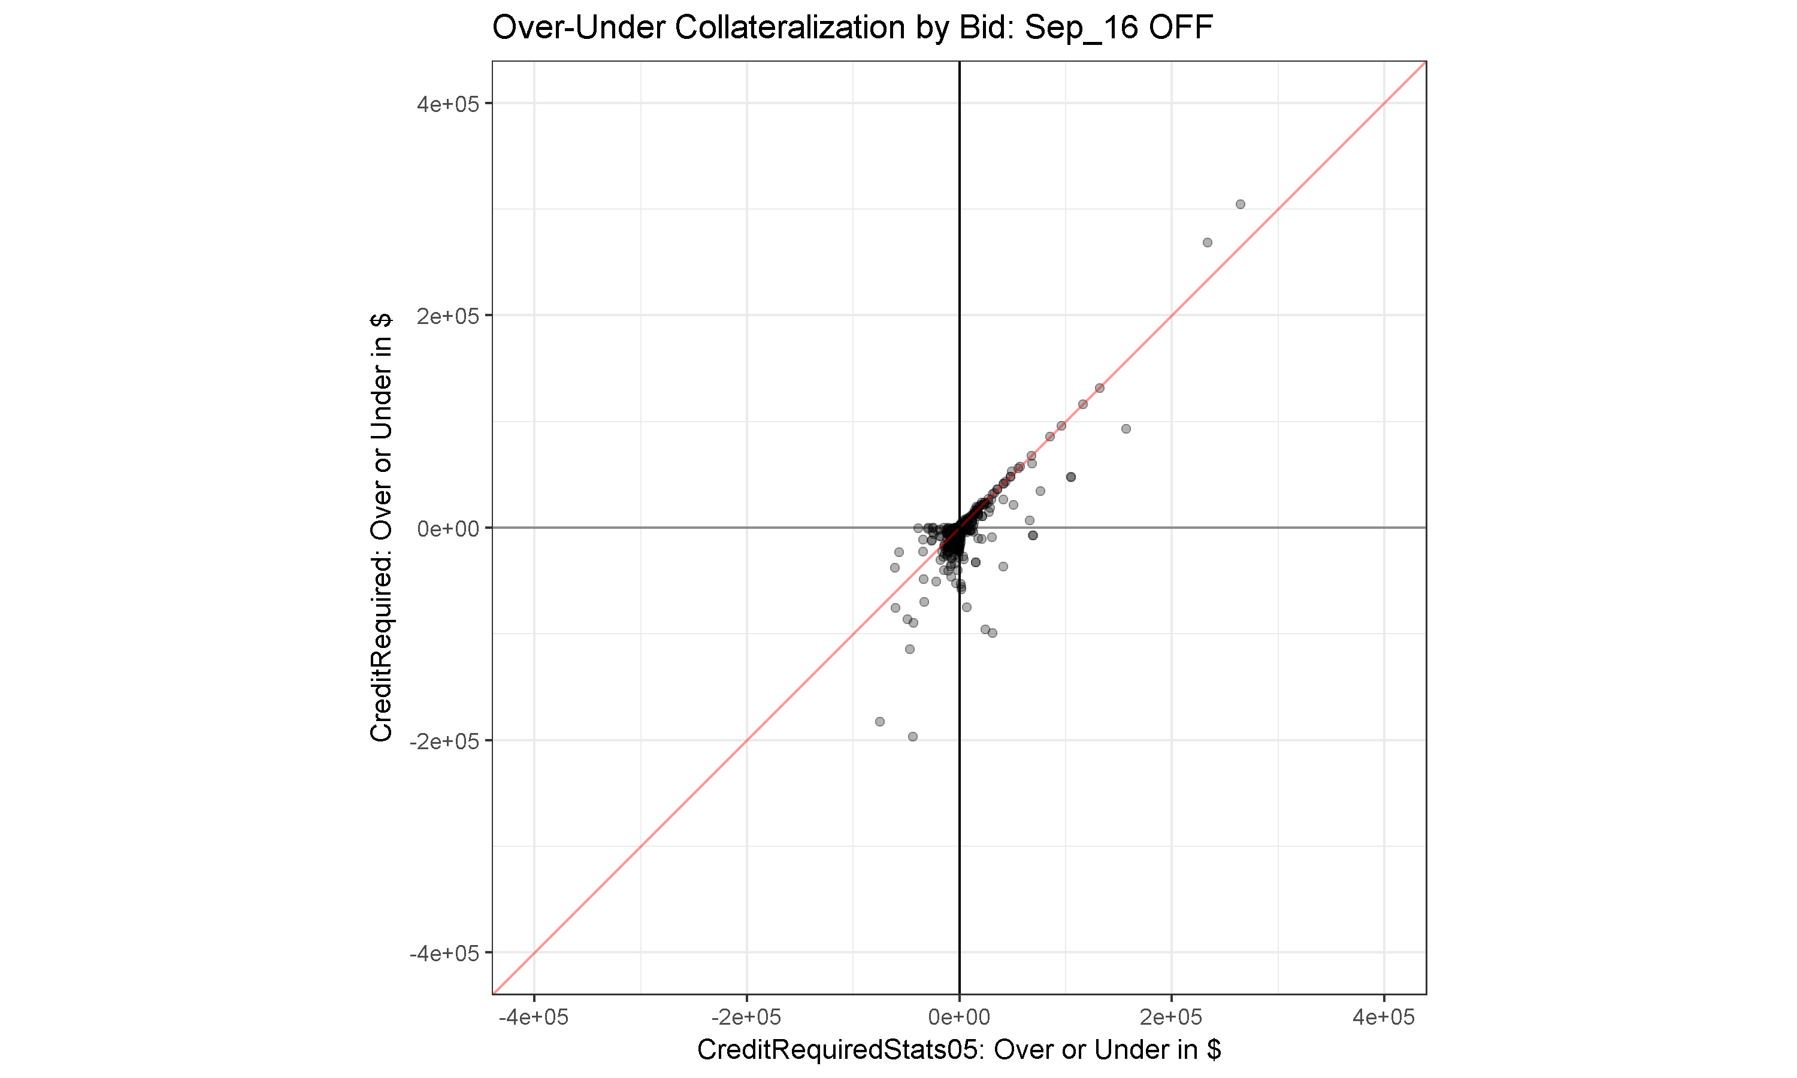
$400K
$200K
$0
-$200K
-$400K
-$400K
-$200K
$0
$200K
$400K

Slide 50
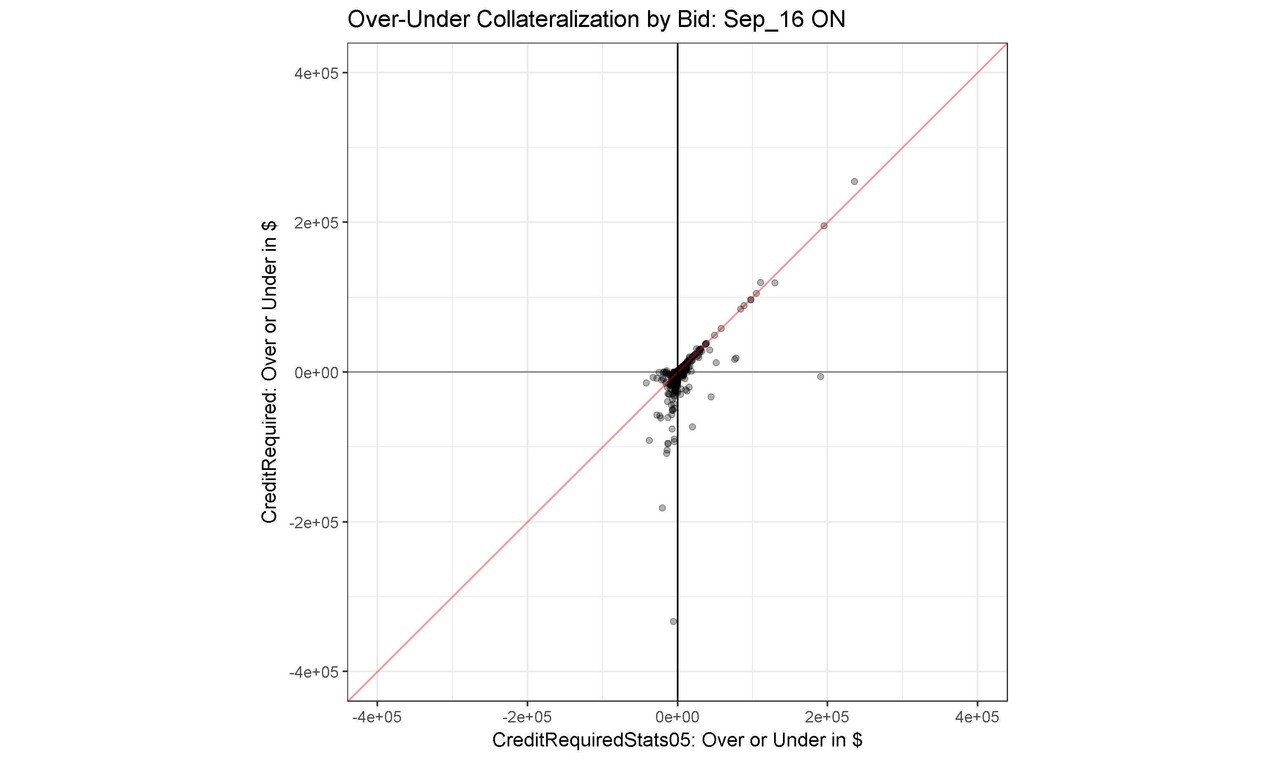
$400K
$200K
$0
-$200K
-$400K
-$400K
-$200K
$0
$200K
$400K

Slide 51
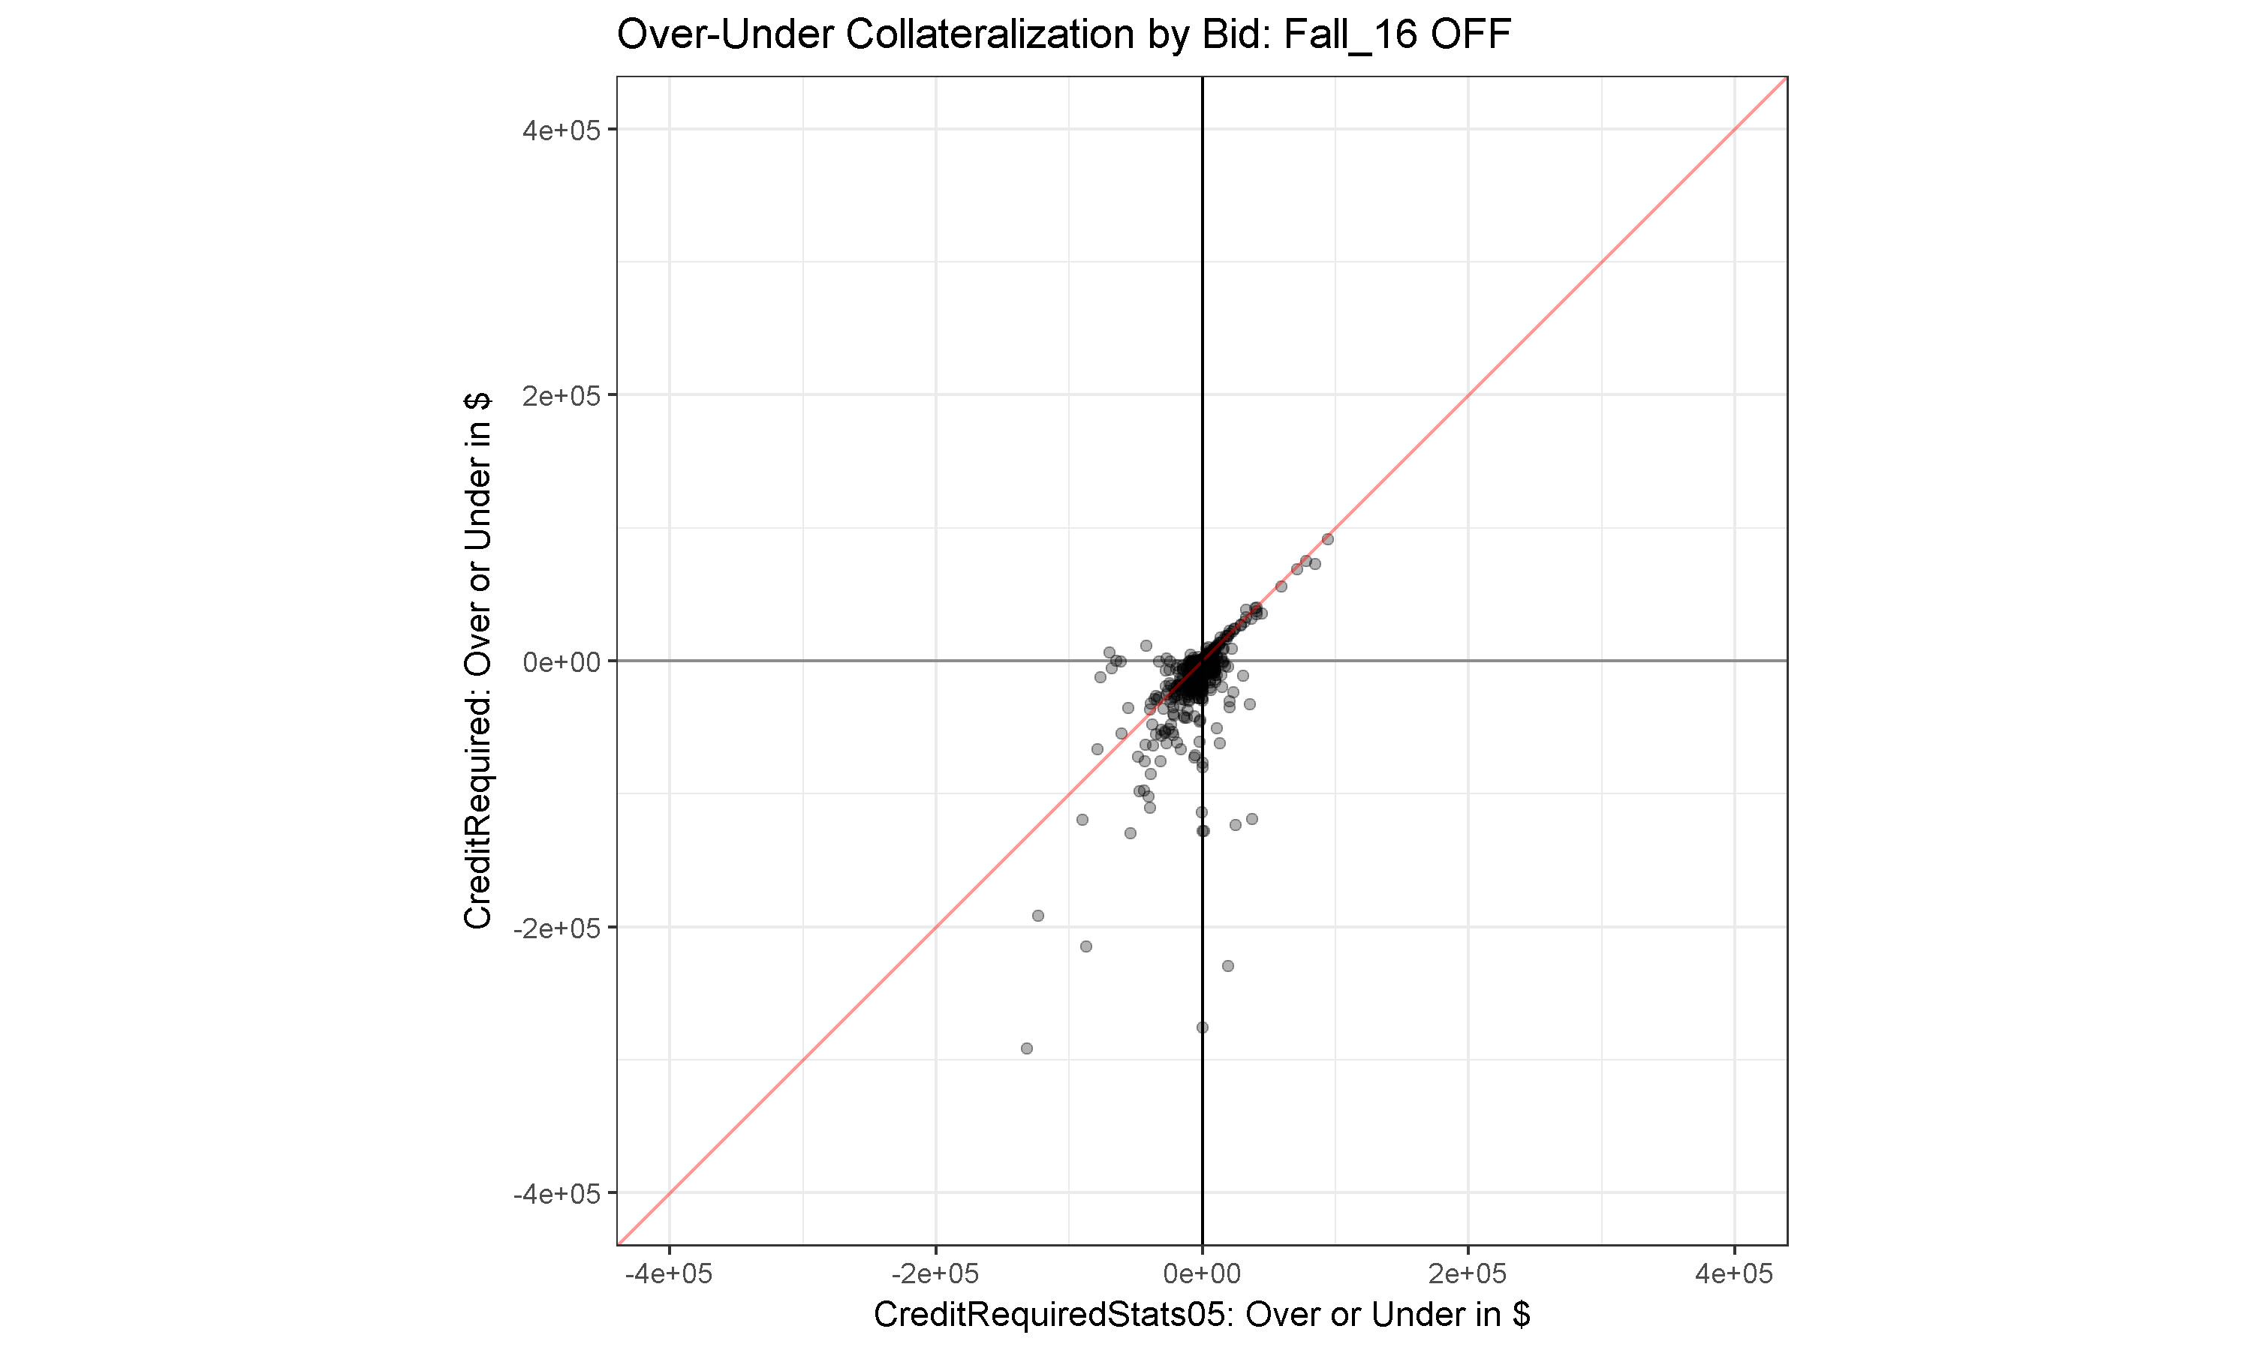
$400K
$200K
$0
-$200K
-$400K
-$400K
-$200K
$0
$200K
$400K

Slide 52
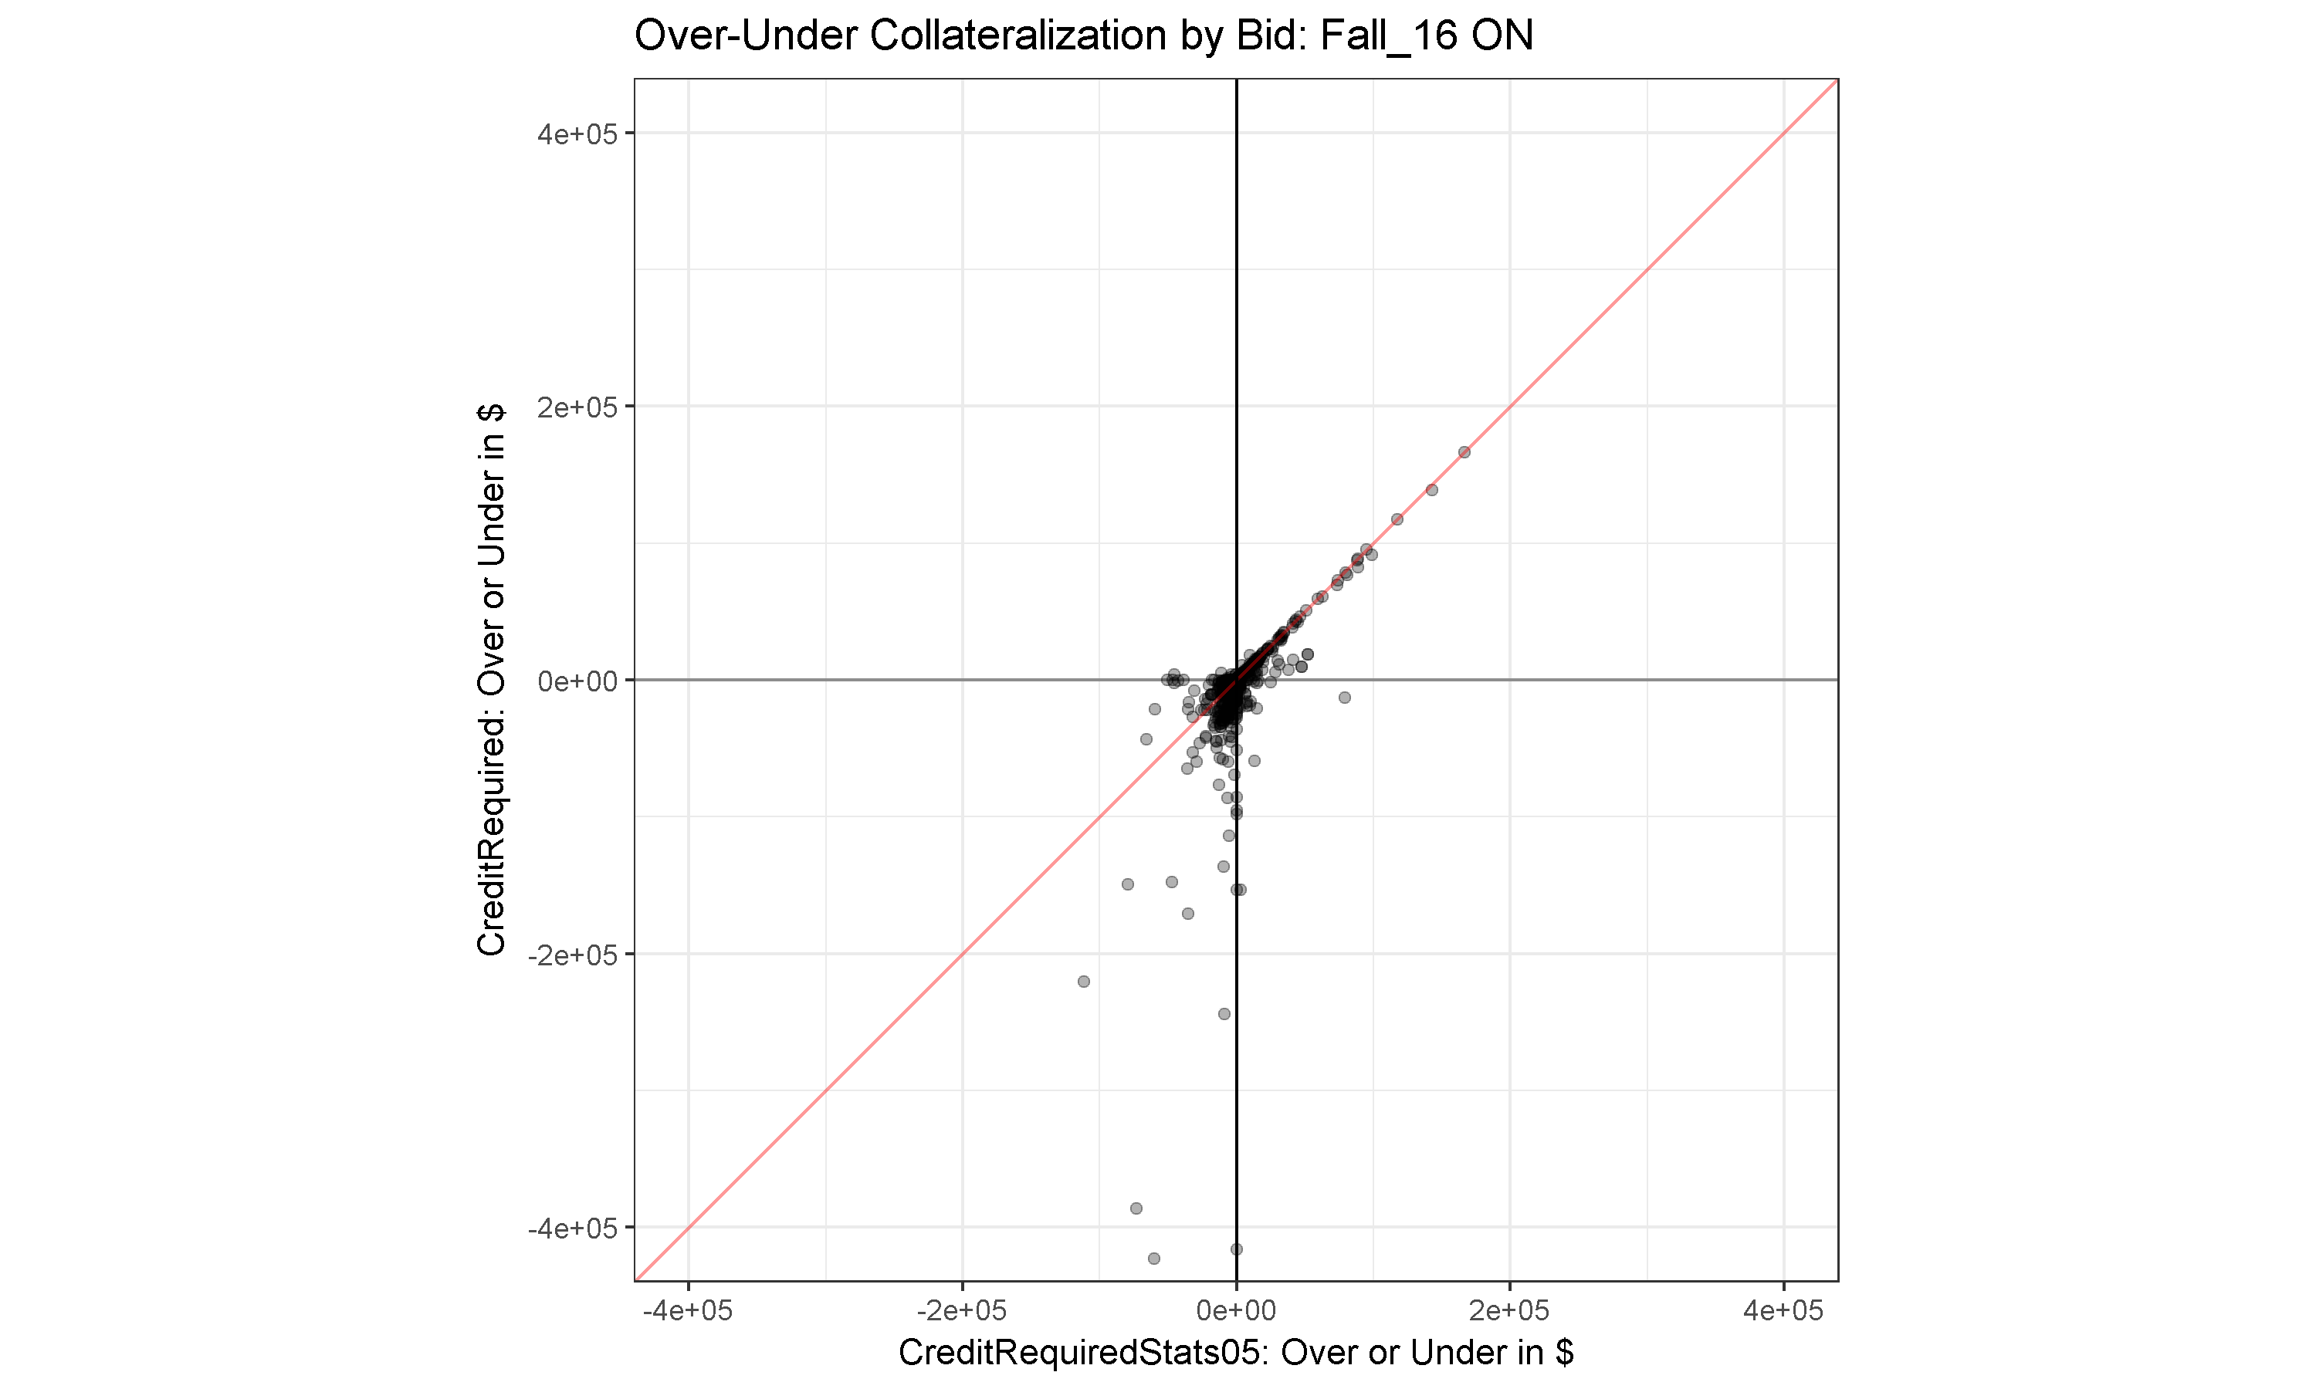
$400K
$200K
$0
-$200K
-$400K
-$400K
-$200K
$0
$200K
$400K

Slide 53
$400K
$200K
$0
-$200K
-$400K
-$400K
-$200K
$0
$200K
$400K

Slide 54
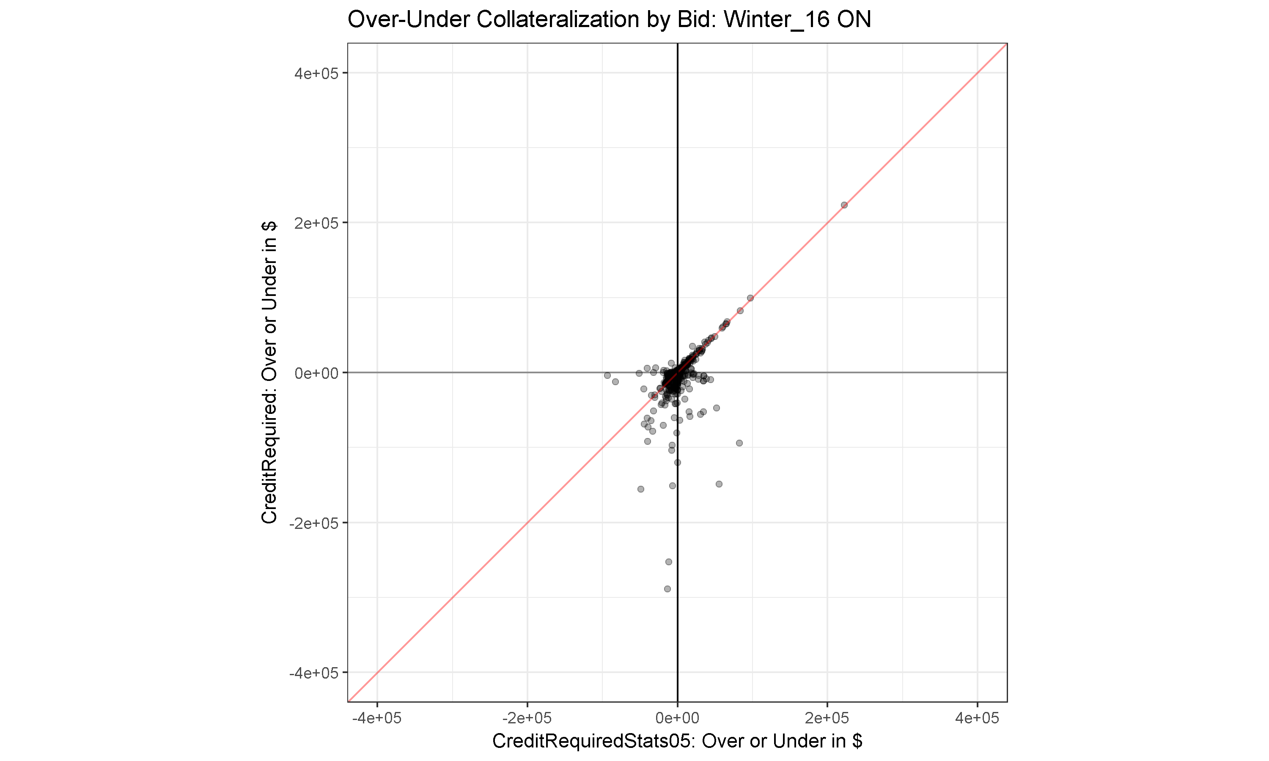
$400K
$200K
$0
-$200K
-$400K
-$400K
-$200K
$0
$200K
$400K

Slide 55

$400K
$200K
$0
-$200K
-$400K
-$400K
-$200K
$0
$200K
$400K

Slide 56


